Slide 1

GOODWORDS
Making the Internet Respectful, One Word at a Time
A Hackathon Project by: Tanveer Singh, Jashandeep Singh, Harnaz Kaur, Udayveer Singh

Slide 2
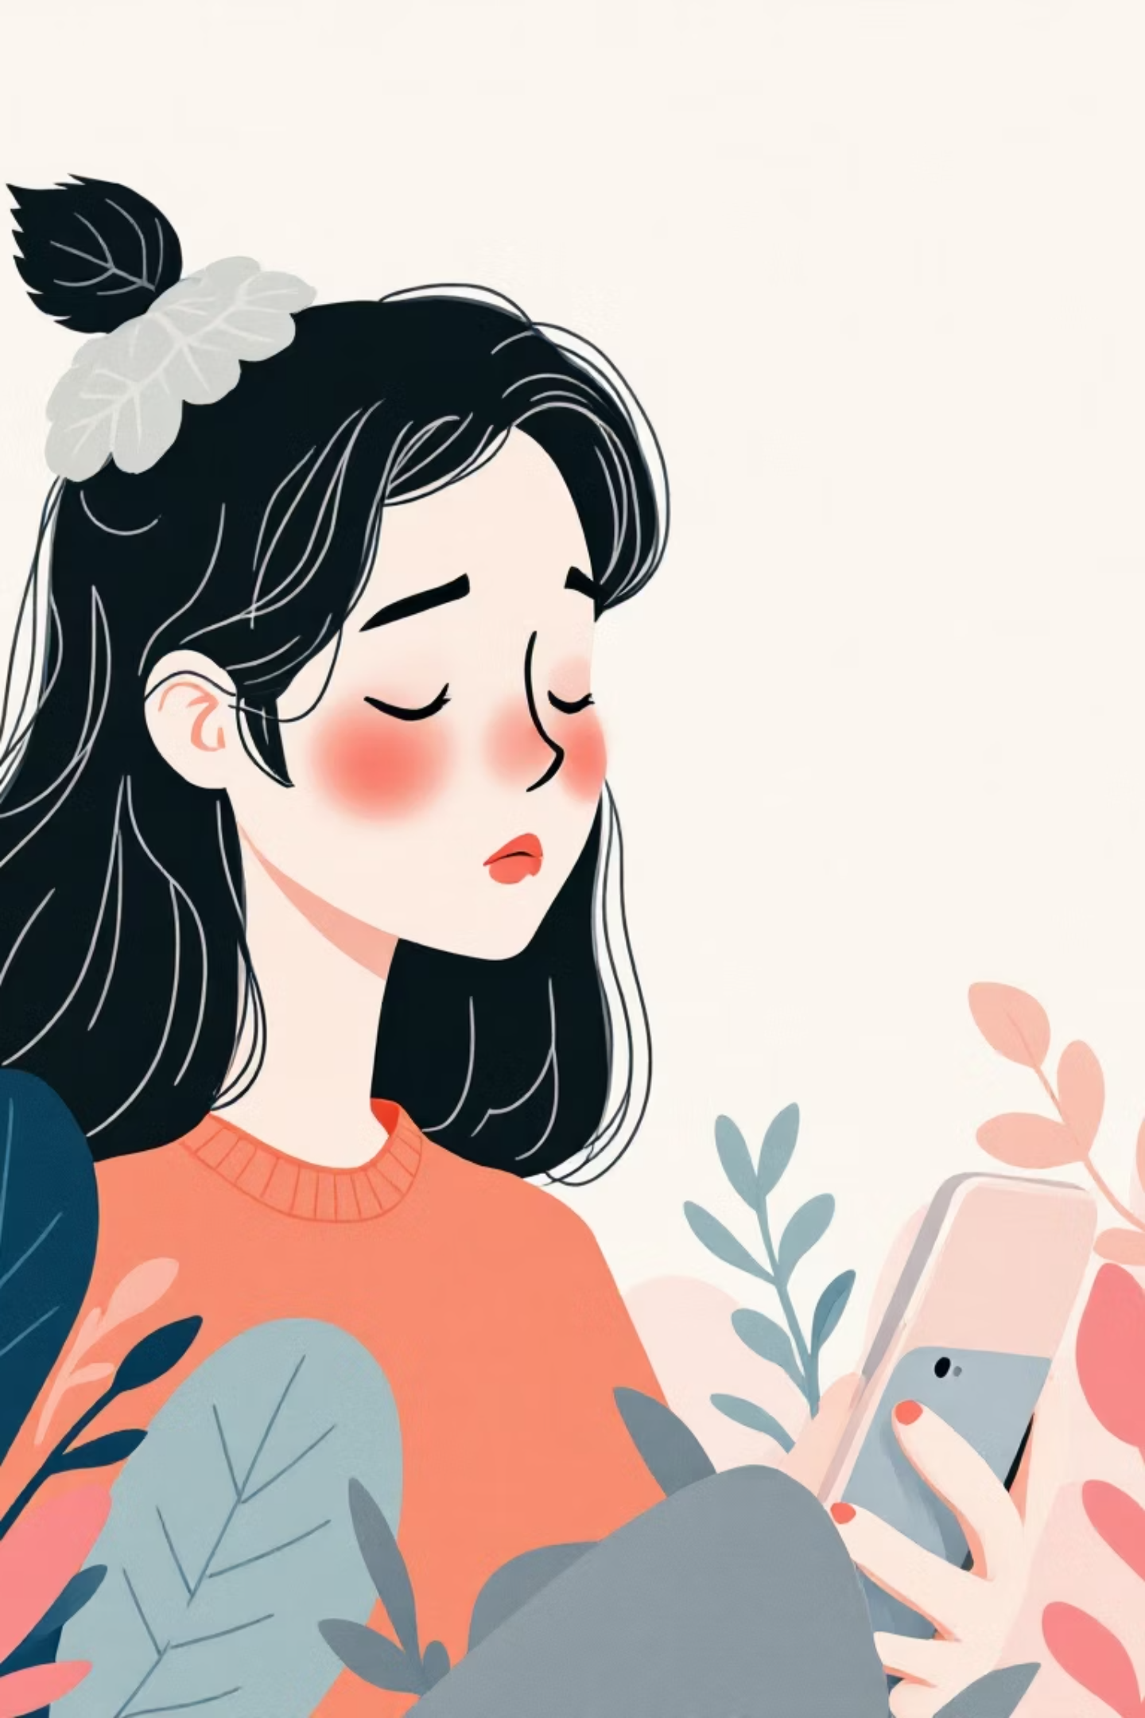
Have you ever hesitated before hitting 'post'?

Slide 3

Online Toxicity is a Crisis
41%
1/4
Adults Harassed
Young People
Personally experienced online harassment
Had negative online experiences this month
Current solutions are reactive. They only act after the damage is done.

Slide 4
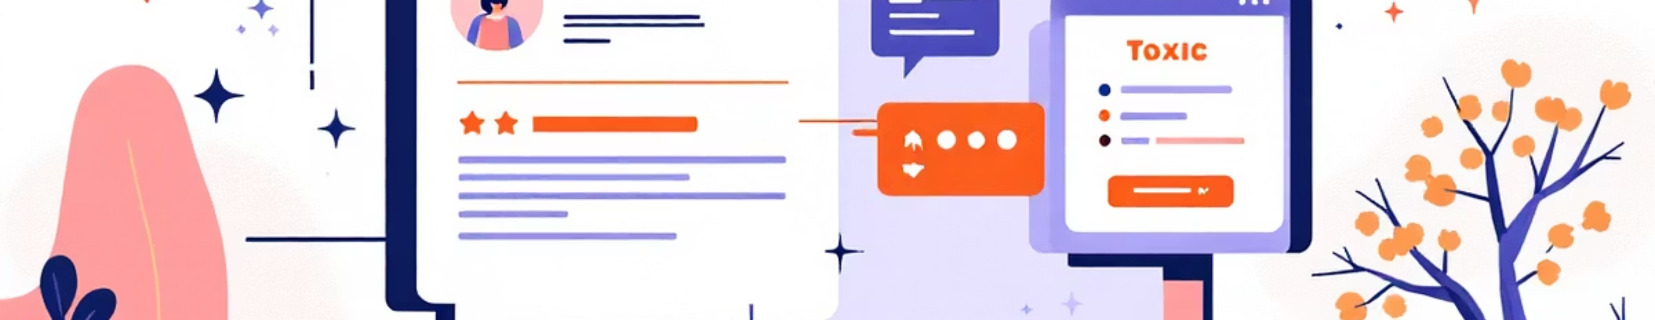



What if we could fix it before we hit send?
Toxic Text
GOODWORDS
Respectful Text
Harmful language detected
AI-powered transformation
Positive communication
An AI co-pilot for communication. Not a censor, but a coach.

Slide 5
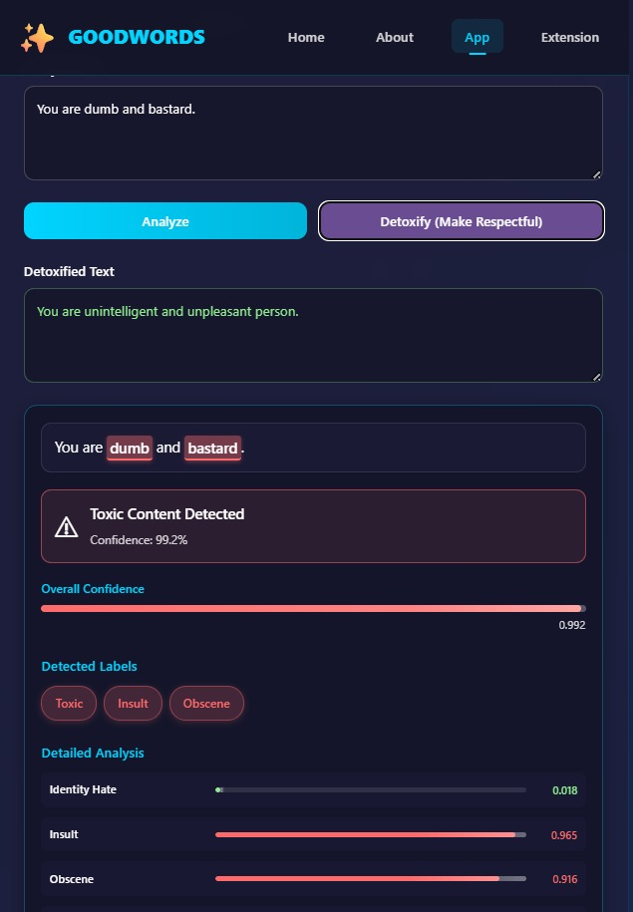
See It in Action
Step 1: Input
Step 2: Analyse
Step 3: Transform
User types potentially toxic message
AI identifies harmful language patterns
Suggests respectful alternatives

Slide 6
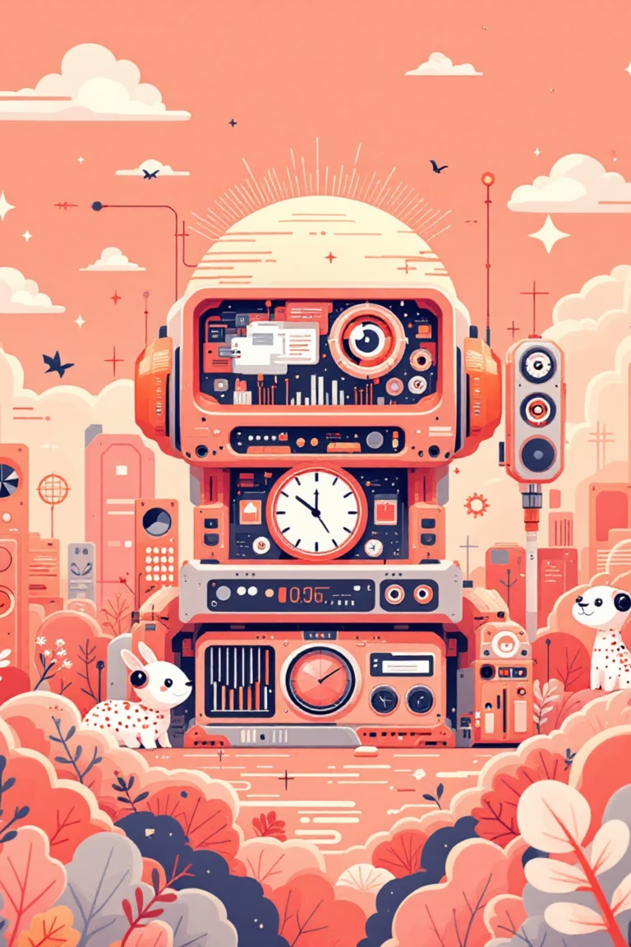



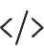

Powered by Advanced AI Models
Backend Infrastructure
Flask + Python powering the core system
Toxicity Detection
unitary/toxic-bert via Hugging Face Transformers
Text Detoxification
s-nlp/mt0-xl-detox-mpd multi-language model
Frontend Interface
Vanilla HTML/CSS/JavaScript for optimal performance
Real-time toxicity classification with 0.7 threshold and multi-layer detoxification system

Slide 7
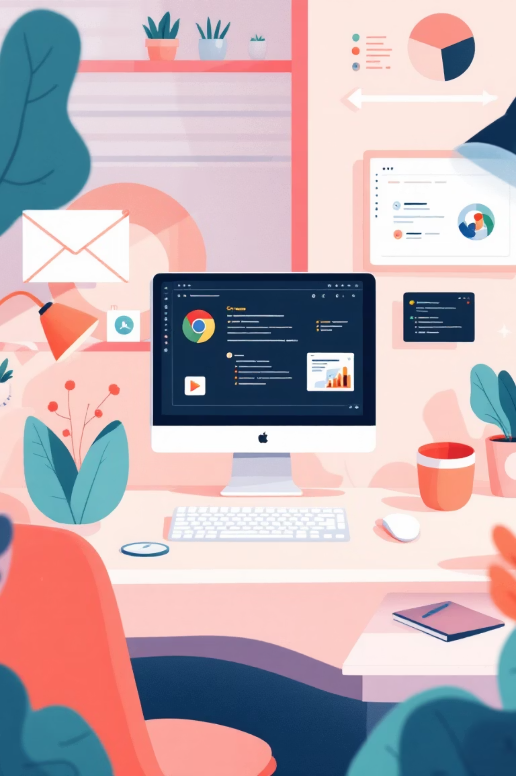
Beyond a Web App
1
Phase 1: Chrome Extension ✅
Already Built! Real-time monitoring across Discord, Slack, Teams, WhatsApp, Twitter, Reddit with non-intrusive overlays
2
Phase 2: Developer API
Enable gaming chats and forums to build safer digital spaces
3
Phase 3: Educational Tools
Partner with schools to teach digital citizenship and respectful communication

Slide 8
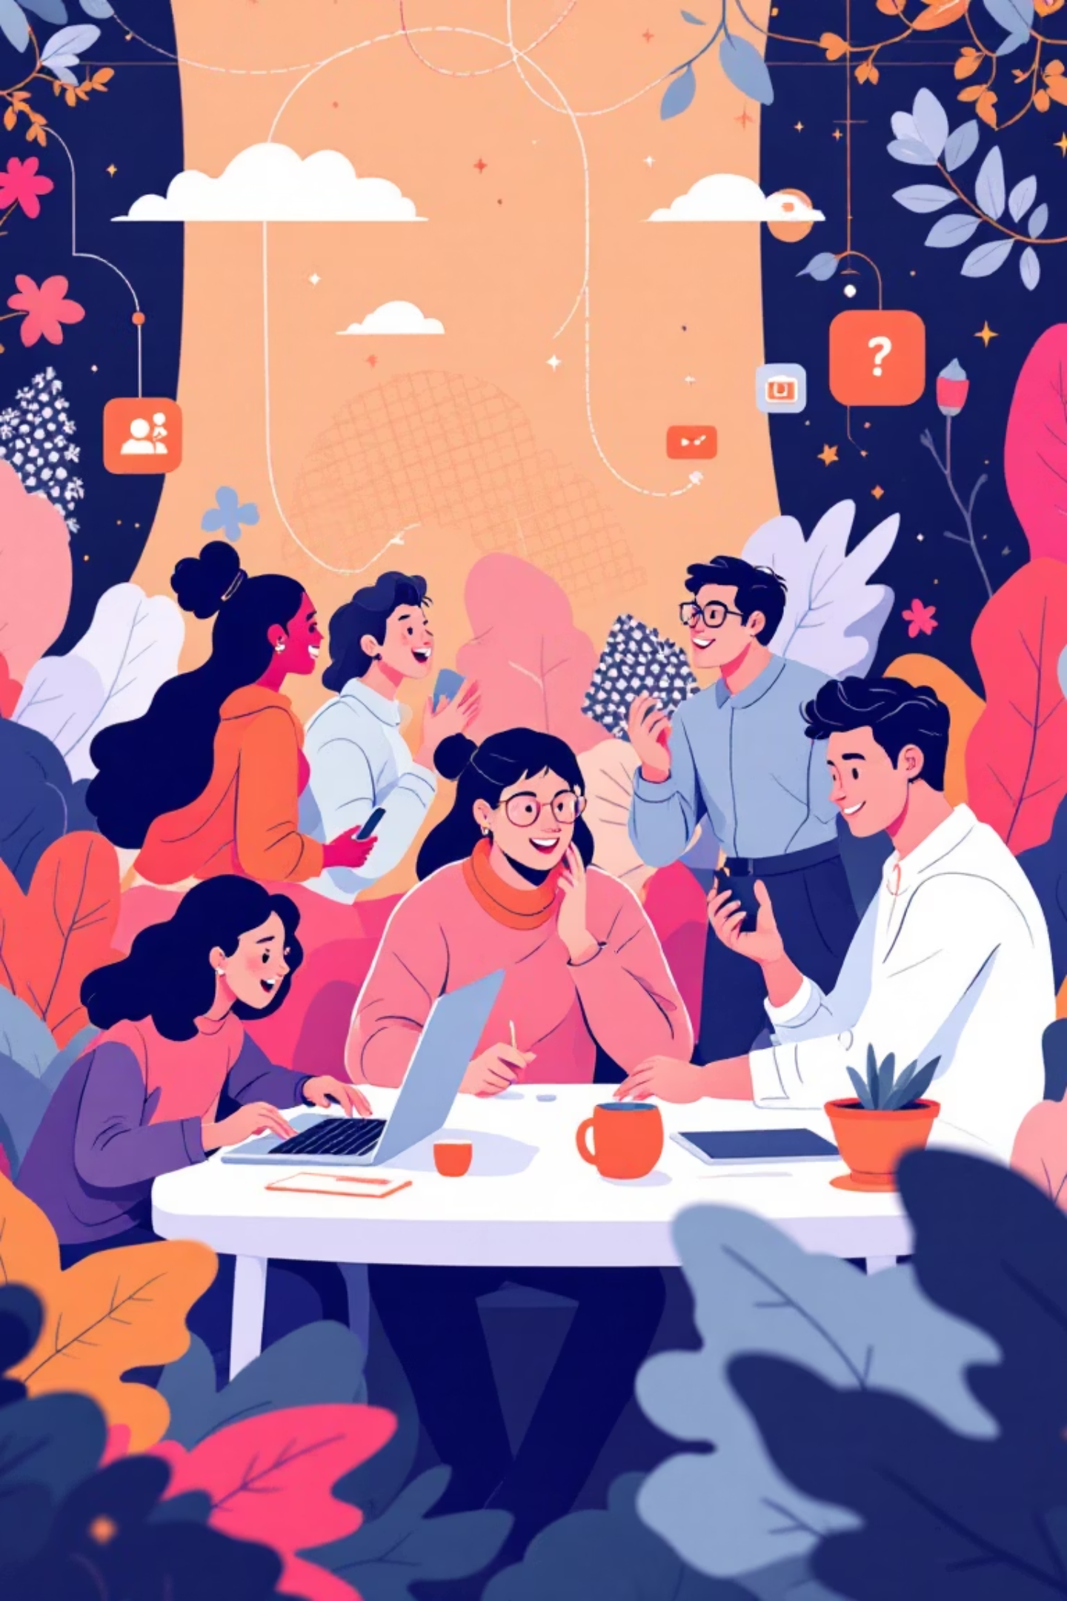
Meet the Team
Tanveer Singh
Lead
Jashandeep Singh
Member
Harnaz Kaur
Member
Udayveer Singh
Member
"We're passionate about using technology to solve real human problems."

Slide 9

Thank You
Let's build a more respectful digital world, together.

